Slide 1



Business Analysis 101
Notes:
Introduce the topic
Don’t need any business analysis experience
Questions

Slide 2





Aviwe Qata
Business Analyst @ Entelect
Notes:
Introduction
Name
Role
Hobbies

Slide 3
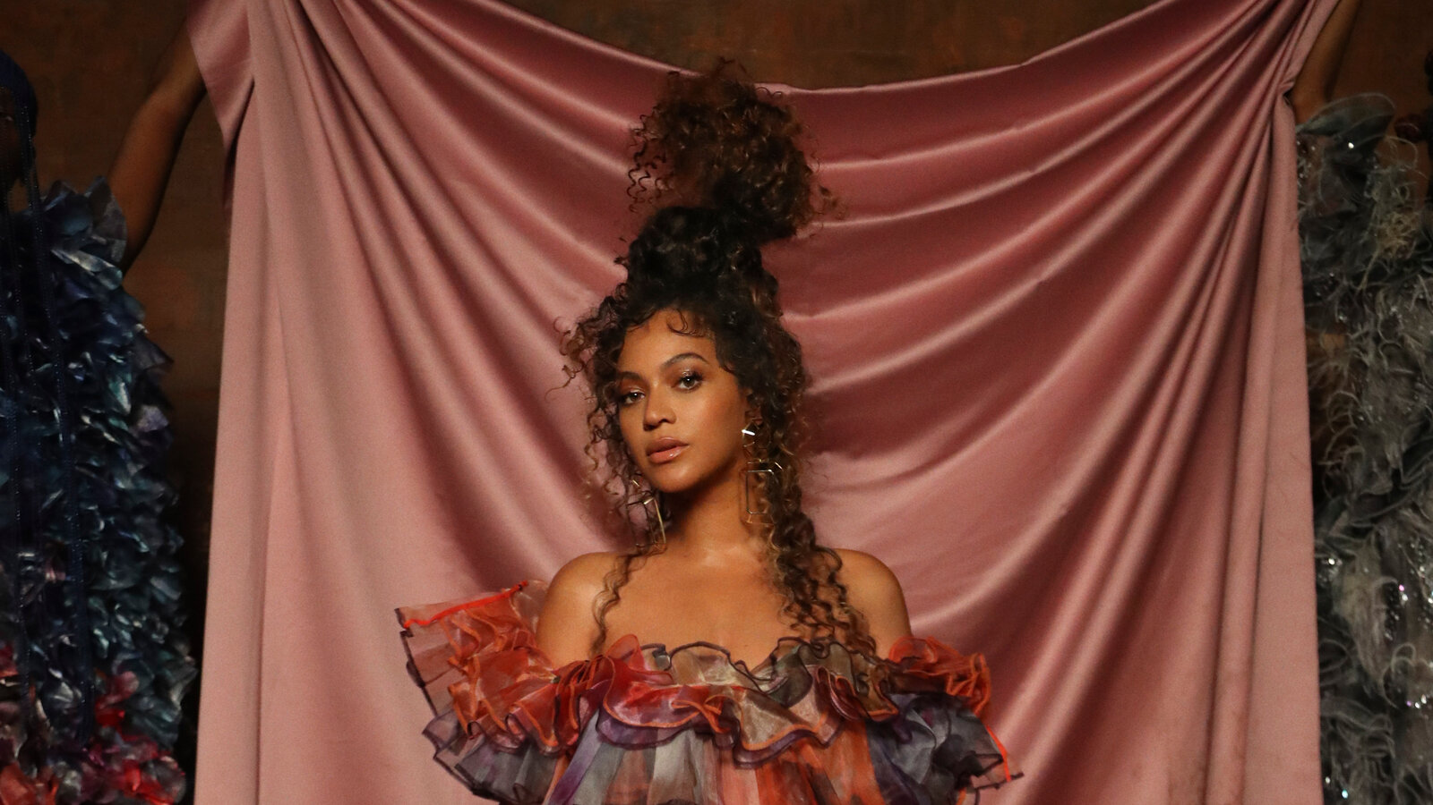







Slide 4
Content
Definition of Business Analysis
Skills required for Business Analyst
Role and Importance
Business Analyst vs Systems Analyst
Common challenges

Slide 5
Content
Organizational role
The responsibilities of a Business Analyst
Tools used by a Business Analyst
Business Analyst in Agile

Slide 6

What is Business Analysis?
Business analysis is the practice of enabling change in an organizational context, by defining needs and recommending solutions that deliver value to stakeholders.
Notes:
Enabling change - facilitate and coordinate
Defining needs – Translate and analyze
Deliver value - simplify

Slide 7
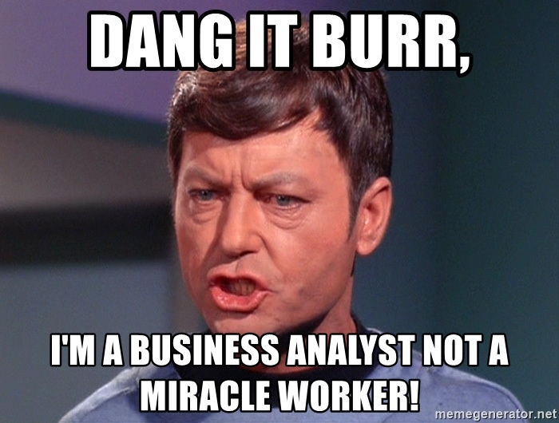

What skills does a business analyst need and why?

Slide 8
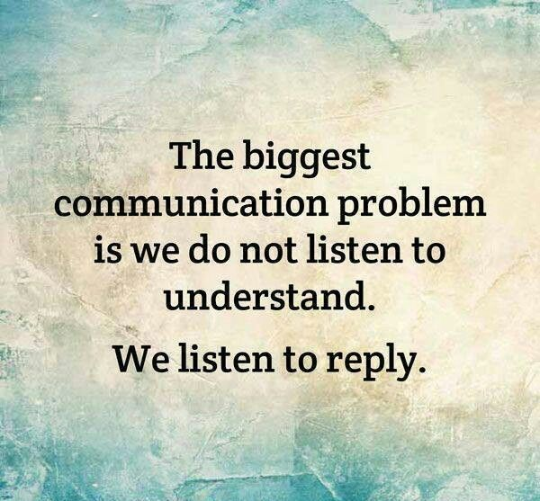
Business Analyst Skills
Analytical
Communication
Creative
Listening ability
Curiosity
Quick learner
Task switching
Notes:
Analytical - ability to collect and analyze information, problem solve and be able to make decisions
Communication – use pictures , stick to the point
Creative – think out the box, don’t look at situations one dimensional
Listening ability – listen to understand not to reply
Curiosity – ask question all the time
Quick learner – be agile about your learning
Task switching – be able to do multiple task in a day
-a BA does not need technical expertise like coding or maths

Slide 9
Business Analyst
Business Analyst vs. Business Systems
Systems Analyst
Determine system requirements.
Identifying inputs and outputs for systems needs.
Creating diagrams, flowcharts, and specifications to be used by programmers.
Liaising between business stakeholders.
Assessing the business practices for insufficiencies.
Making recommendations for solutions.
Notes:
There are some similarities, but there are defining differences

Slide 10
Business Analyst
Business Analyst vs. Business Systems
Systems Analyst
Assessing and communicating the needs raised by stakeholders.
Administering the application, coordinating tests, and observing system performance to ensure improvement.

Slide 11

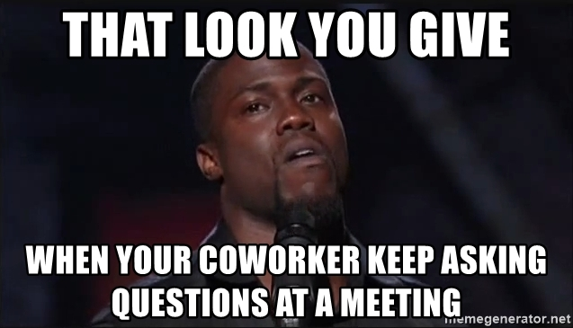
What are some questions a Business Analyst should ask themselves?
Notes:
In general: What are some of the questions that a BA should ask themselves or if you are a BA what are some of the questions you’ve asked yourself?

Slide 12
How can we focus our work to create more value and productivity?

Slide 13
Role
Understanding the basic business structure and process.
Understand the business value proposition.
Understand the business domain.
Gather, elicit, document, analyze and model.
Drive product value by implementing solutions.
Notes:
As a BA you need one of your primary objectives is to understand the basic business structure and process of the organization
This results in grasping what the business goals are thus bringing forth the business value proposition
And once you understand those intentions as a BA, you dive dipper into the business domain, eg
Different product offered
Revenue streams
Basically, understanding the full picture
On a day-to-day basis a BA needs to gather, elicit, analyze, and be able to interpret business requests
Document and model business process and requirements
Various stakeholders
Clear, make sense and have less ambiguity as possible
This then results in driving product value by implementing solutions
Establishing trust

Slide 14

Can you think of any challenges a Business Analyst might face.

Slide 15
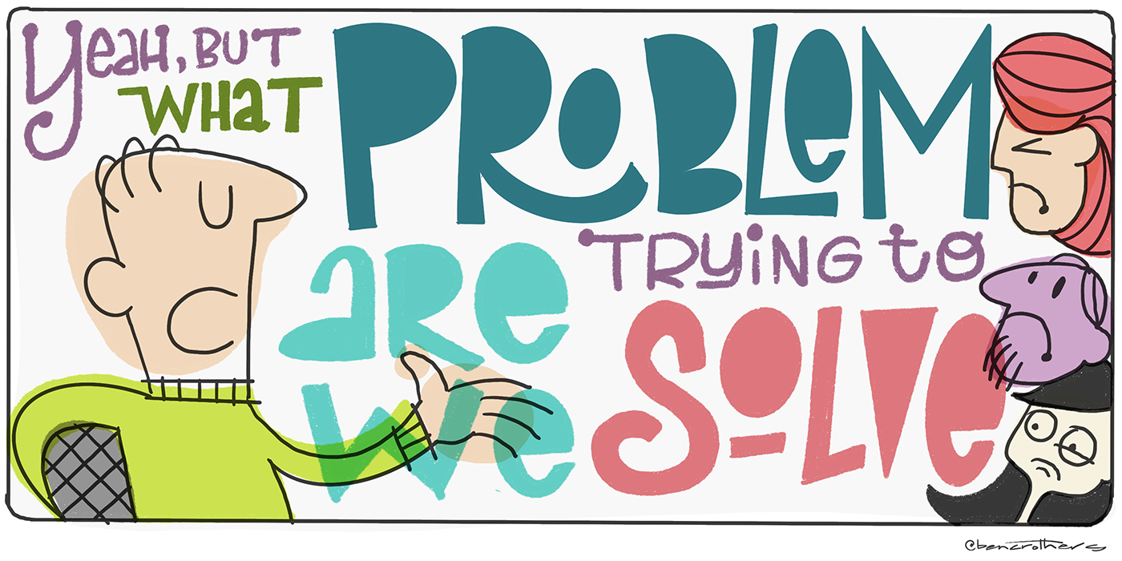
Challenges for a Business Analyst
Not well-defined business requirements.
Incomplete requirements.
Unrealistic expectations.
Lack of executive support.
Multiple document review delay sign off.
Changing requirements.
Scope creep.
Lack of planning.

Slide 16

Scenario
Notes:
Restaurant = Business
Floor manager = Scrum Master
Lady in the white = Product Owner
Chef = Developers
Waitress = Business Analyst

Slide 17
Element | Example
Key Partners | Food Supplier.
Key Activities | Point of Sale.
Key Resources | Cleaners.
Value Proposition | Good food.
Customer Relationships | Customers and their expectations.
Organizational Role
Understanding the Business
Notes:
Point of sale: This computerized system allows business owners to track sales, cash flow, food inventory and can help simplify your bookkeeping enormously.

Slide 18
Element | Example
Channels | Booking system.
Cost Structure | Operating costs and development costs.
Revenue Streams | Number of meals sold.
Customer Segments | Important customers e.g regulars vs new customers
Organizational Role
Understanding the Business

Slide 19
What key elements can we use to understand the project?
Notes:
-using the scenario above. We have a project coming up to get more people in the restaurant coming to watch soccer.

Slide 20




Organizational Role
Understanding the Project
People
Goal settings
Timeframe
Environment
Notes:
Goal settings – purpose, success criteria, scope, outcomes
People – team, stakeholders, users
Timeframe – Milestones , actions
Environment – resources , constraints , risks

Slide 21

Business Analyst Responsibilities
Gather
Elicit
Document
Model
Analyze
Notes:
-Can do these task concurrently

Slide 22
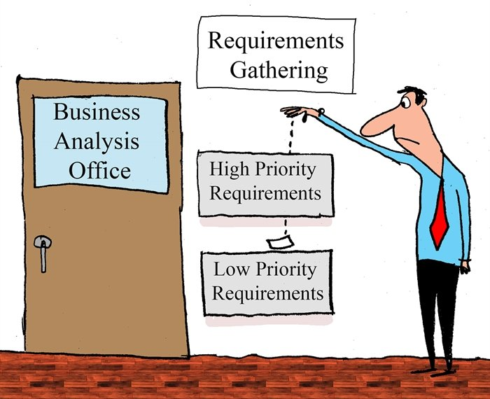
Gather
Notes:
https://www.phase2technology.com/blog/successful-requirements-gathering
Getting supporting material

Slide 23
Gathering Requirements
Establish project goals and objectives early.
Be transparent with requirements documentation.
Talk to the right stakeholders and users.
Don’t make assumptions about requirements.
Notes:
Explain this using a practical example
Express the importance of not finding the actual problem

Slide 24
Gathering Requirements
Confirm, confirm, confirm.
Practice active listening.
Focus on business requirements, not tools.
Prioritize your product features.
Remember that you didn’t get everything.

Slide 25

Elicit
Notes:
The act of calling forth or draw out unstated and implied needs of the business problem presented. Not just what the SME is telling you but also what are they not telling you.
Like how in the SDLC world they say when you dev one of the things you think about is how can the user brake this

Slide 26
From the above, which ones do you think are elicitation techniques?
Brainstorming
Prototyping
Jira board
Observing
Agile session

Slide 27
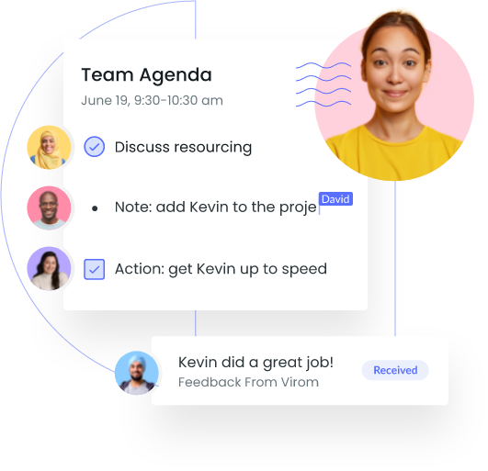
Eliciting and Communicating Requirements
Elicitation process:
Introduction
Body
Close
Follow-Up
Notes:
Introduction
Knowledge of the different stakeholders you have in the room
Understand what needs to be achieved
Outline problem/issue
Highlight expected outcomes and benefits
Have a plan to follow
Body –
Gather information from stakeholders
Seamless transition
Soft skills are key
Close –
Appreciate stakeholders
Receive feedback
Plan of action items
Follow-Up –
Summary of findings
Helping with validation

Slide 28
Eliciting and Communicating Requirements
Direct Elicitation methods:
Brainstorming and facilitated workshops.
Effective focus groups.
Interviews.
Notes:
Direct Elicitation methods:
Brainstorming & facilitated workshops.
Covid and needing to learn to facilitate online
Especially for big projects
Filtering in on problems
Making sure the content is relevant to the problem
Developing & conducting workshops.
Inspired to Work Better
Provide new information and business knowledge
Effective focus groups.
Separating your UX, Devs, Pos
Focused discussions
Interviews.

Slide 29
Eliciting and Communicating Requirements
Experiential Elicitation methods:
Analyzing documentation.
Observation and simulation.
Prototyping and storyboarding.
Notes:
Experiential Elicitation methods:
Analyzing documentation.
Better understand requirements
Observation & simulation (looking at business processes).
Needing practical representation of how systems work
Screen share and online walkthroughs
Prototyping & storyboarding.
More agile and lessens documentation
Point can be made quicker and can skip steps,
Doing user stories as a BRS

Slide 30
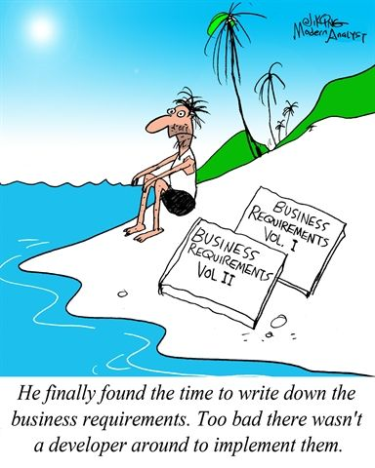
Analyze
Notes:
-Determining whether the stated requirements are clear, complete, unduplicated, concise, valid, consistent and unambiguous, and resolving any apparent conflicts.

Slide 31
How would we group our requirements that we have just elicited?

Slide 32
Analysing Requirements
Functional Requirements
Notes:
-These define how a product/service/solution should function from the end-user's perspective.
-They describe the features and functions with which the end-user will interact directly.
Functional requirements explain how the system must work
Business Rules.
Authentication.
Non-functional requirements focus on user expectations, as they are product properties.
Let's take an example of a functional requirement. A system loads a webpage when someone clicks on a button.
The related non-functional requirement specifies how fast the webpage must load
Portability
Compatibility
Capacity

Slide 33
Analysing Requirements
Operational Requirements
Notes:
These define operations that must be carried out in the background to keep the product or process functioning over a period.
Pertain to the scenarios within which the product will operate. Operational requirements usually cover the following concerns:
•Mission profiles
•Infrastructure needed

Slide 34
Analysing Requirements
Technical Requirements
Notes:
Technical requirements typically refer to how the software is built
These define the technical issues that must be considered to successfully implement the process or create the product.

Slide 35
Analysing Requirements
Transitional Requirements
Notes:
A transition requirement describes a requirement that must be in place for a certain phase or period.
These are the steps needed to implement the new product or process smoothly.

Slide 36
Analysing Requirements
Prioritize requirements
Analyze the impact of change
Resolve conflicting issues
Analyze feasibility
Notes:
Prioritize requirements – Although many requirements are important, some are more important than others, and budgets are usually limited.
Therefore, identify which requirements are the most critical, and which are "nice-to-haves".
Analyze the impact of change – carry out an Impact Analysis to make sure that you understand fully the consequences your project will have for existing processes, products and people.
Resolve conflicting issues – Sit down with the key stakeholders and resolve any conflicting requirements issues.
Analyze feasibility – Determine how reliable and easy-to-use the new product or system will be.

Slide 37
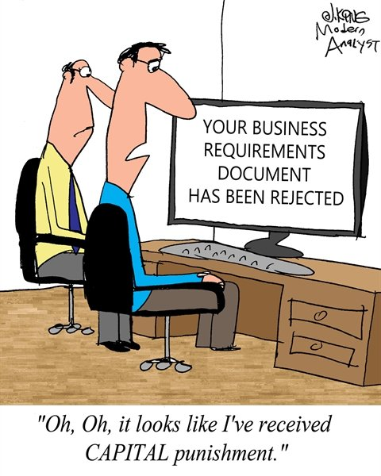
Document
Notes:
-Documentation is one of the integral job functions of a business analyst, throughout the course of a project, prepares many documents

Slide 38
Why do you think documentation is important?

Slide 39
Documenting Requirements
1. Business Requirements Document (BRD)
2. Functional Requirements Document (FRD)
3. Market Requirements Document (MRD)
4. Product Requirements Document (PRD)
5. User Interface Requirements Document (UIRD)
6. Technical Requirements Document (TRD)
7. Quality Requirements Document
8. Software Requirements Document or Software Requirements Specification (SRS)
9. Customer Requirements Document
Notes:
Statement of Work
-https://www.modernanalyst.com/Resources/Articles/tabid/115/ID/5464/9-Types-Of-Requirements-Documents-What-They-Mean-And-Who-Writes-Them.aspx
1. Business Requirements Document (BRD)
Also known as a Business Needs Specification.
A BRD is the first stage in a product life cycle.
It details the problems that a product/service/system is trying to solve by logically listing high-level business requirements in relation to customers’ needs.
Features includes:
An outline of the requirements of the project
Objectives of the project
A needs statement detailing why the project is needed and how it will meet those needs
Financial statements, demonstrating how the project will be funded and its effect on the company’s balance sheet
Functional requirements and features
Personnel needs. Who do we want to work on the project?
Schedule, timeline and deadlines
t’s normally a single page with a bullet-type list.
2. Functional Requirements Document (FRD)
An FRD defines in logical terms, how a system or project will accomplish the requirements laid out in the BRD. It outlines the functionality of the system in detail by capturing the intended behaviour of the system, expressed as services, tasks or functions that the developers have agreed to provide.
Rather than define the ‘inner-workings’ and specifications, an FRD focuses on what users might observe when interacting with the system.
An example functional requirement might be: “When the user clicks the OK button, the dialog is closed and the user is returned to the main window in the state it was in before the dialog was displayed."
An FRD sometimes includes screen mockups or wireframes to illustrate the system’s design.
Depending on the complexity, FRDs can vary in length from 10 pages to several hundred.
An FRD is normally written by the business analyst or systems analyst.
3. Market Requirements Document (MRD)
Sometimes referred to as a Marketing Requirements Document, an MRD focuses on the target market’s needs. It typically explains: What the product is, who the target customers are, what products are in competition with it and why customers are likely to want this product.
An MRD typically includes:
A definition of the target market, an imagining of the potential buyer or user
A comprehensive list of market requirements the solution will need to satisfy
Indicators of success for each requirement
A prioritized list of requirements from your market’s point of view
A timeframe for the product’s launch
An MRD is normally prepared by the marketing manager or product manager.
4. Product Requirements Document (PRD)
A PRD is used to communicate everything that must be included in a product release for it to be considered complete. It is written from a user’s point-of-view to understand what a product should do.
It usually includes the same content as an FRD, but with ‘non-functional requirements’ added. Although non-functional requirements are not related to the functionality of the product, it’s often important to identify them - they may include such needs as reliability, security and scalability.
5. User Interface Requirements Document (UIRD)
A UIRD describes the look and feel of the User Interface (UI) of the system.
A UIRD more often than not includes mockup screenshots and wireframes to give readers an idea of what the finished system will look like.
It’s written by the user interface design team.
6. Technical Requirements Document (TRD)
A TRD contains the software, hardware and platform requirements of the product. It includes requirements like the programming language the system should be developed in and the processor speed required to run the system.
It might also consider the limitations of the system and its performance.
A TRD is written by the engineering team.
7. Quality Requirements Document
The quality requirements document outlines the expectations of the customer for the quality of the final product. It consists of various criteria, factors and metrics that must be satisfied.
Quality requirements might revolve around reliability, consistency, availability, usability, maintainability, and customer experience.
This document can be written by the project manager or business analyst
8. Software Requirements Document or Software Requirements Specification (SRS)
An SRS outlines the features and the intended behaviour of a system. It describes the business’s understanding of the end user’s needs while laying out functional and non-functional requirements.
An SRS is related to the FRD and PRD but written with a specific IT project in mind.
An SRS is normally compiled by the lead engineer of the project.
9. Customer Requirements Document
This is sometimes referred to as Client Requirement Document and it can refer to a PRD but for a specific customer or client.

Slide 40
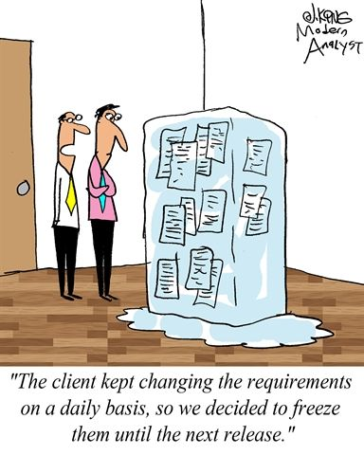
Model
Notes:
Entity-Relationship (ER) diagrams, create a feature model, and efficient prototyping.

Slide 41
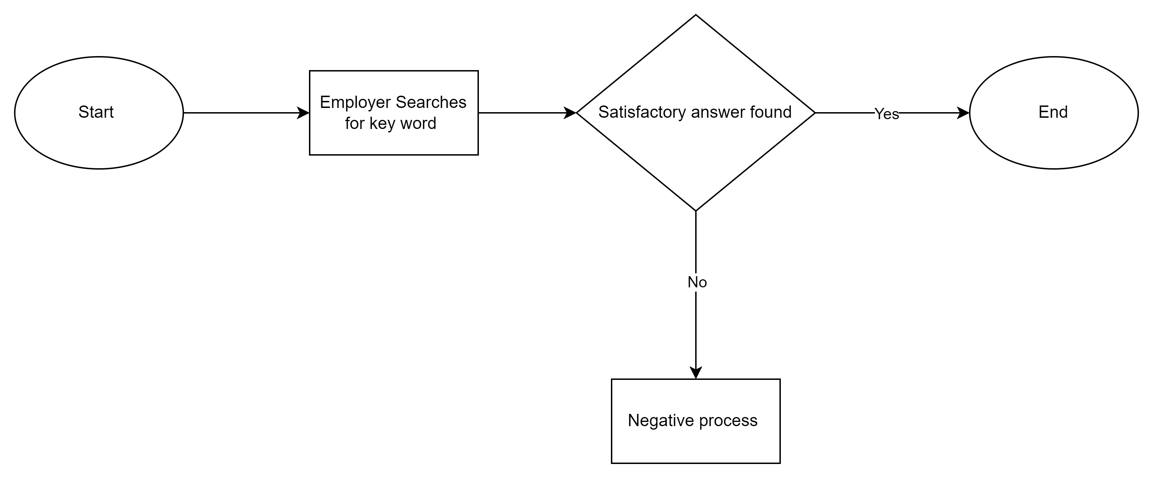
Model Requirements

Slide 42

What is your favorite tool to use from these?

Slide 43

Important Tools
Jira and Confluence
Balsamiq
Draw.io
Notes:
Every Business Analyst working on business requirements and elicitation needs some specialized tools to analyze these requirements.
Jira and Confluence are compelling collaboration tools.
Every Business Analyst must be familiar with the basics of Jira for effective project collaboration and requirements sharing.
The documents will be stored in a centralized repository in Jira.
All the business stakeholders can see the status of projects and communicate with diverse teams using tools like Jira and Confluence.
Balsamiq is a leading cloud-based tool for designing wireframes.
This is an excellent tool for Business Analysts working on New Product Design, brainstorming, and sketching new business ideas.
This tool helps the Business Analyst to communicate his vision for the product to the relevant stakeholders.
It is one of the leading Business Analyst tools for BA.
Draw.io software for making diagrams and charts preferably used to model the requirements.

Slide 44


Communication Tools
Teams
Slack
Zoom
Outlook - email
Discord

Slide 45
Do Business Analysts use the Agile Methodology?
Notes:
-Agile's focus on delivering value to customers requires the entire team to collaboratively perform business analysis on a frequent basis.

Slide 46
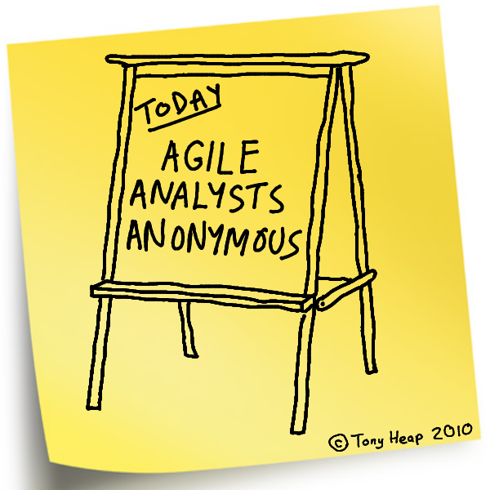
Notes:
-Quick look at a BA in the Agile Environment

Slide 47
Business Analyst in Agile
Assist with discovering what the business users need and want.

Slide 48
Business Analyst in Agile
Determine what changes will have the most value to the business.

Slide 49
Business Analyst in Agile
Effectively use agile software development practices to deliver with maximum efficiency.

Slide 50
Business Analyst in Agile
Make sure that stories in the product backlog produce true value to the business.
Notes:
They need to collaborate with business users and sponsors across the organization, and to gain alignment on what is wanted and needed and ensure that those items in the product backlog and those details in the user stories represent true value to the business.

Slide 51

Facilitating change and innovation

Slide 52


